Slide 1
Python
Shah Ayub Quadri
aquadri@digital-lync.com

Slide 2

Index
Python
• Database
• Database Connection:
• Creating Database Table
• INSERT Operation
• READ Operation
• Update Operation
• Delete Operation

Slide 3
Database
Python Database API supports a wide range of database servers such as −
GadFly
mSQL
MySQL
PostgreSQL
Microsoft SQL Server 2000
Informix
Interbase
Oracle
You must download a separate DB API module for each database you need to access. For example, if you need to access an Oracle database as well as a MySQL database, you must download both the Oracle and the MySQL database modules.
DB API provides a minimal standard for working with databases using Python structures and syntax wherever possible.
This API includes the following:
Importing the API module.
Acquiring a connection with the database.
Issuing SQL statements and stored procedures.
Closing the connection.
We would learn all the concepts using MySQL, so let us talk about MySQLdb module.

Slide 4

Database
What is MySQLdb?
MySQLdb is an interface for connecting to a MySQL database server from Python. It implements the Python Database API v2.0 and is built on top of the MySQL C API.
How do I Install MySQLdb?
Before proceeding, you make sure you have MySQLdb installed on your machine.
If it produces the following result, then it means MySQLdb module is not installed

Slide 5
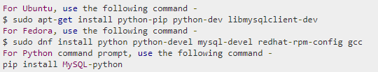
Database
To install MySQLdb module, use the following command:
Database Connection:
Before connecting to a MySQL database, make sure of the followings :
You have created a database TESTDB.
You have created a table EMPLOYEE in TESTDB.
This table has fields FIRST_NAME, LAST_NAME, AGE, SEX and INCOME.

Slide 6
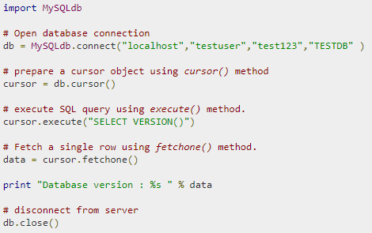
Database
Example
Following is the example of connecting with MySQL database "TESTDB“.

Slide 7
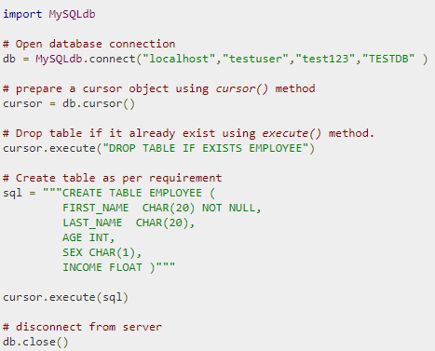
Database
Creating Database Table:
Once a database connection is established, we are ready to create tables or records into the database tables using execute method of the created cursor.
Example
Let us create Database table EMPLOYEE

Slide 8
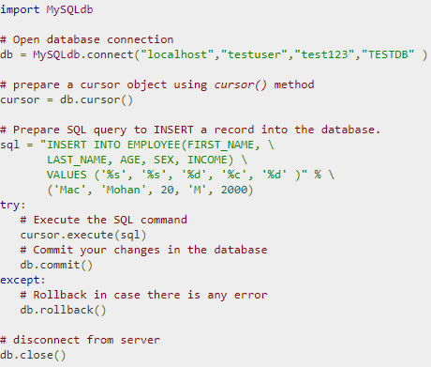
Database
INSERT Operation
It is required when you want to create your records into a database table.
Example
The following example, executes SQL INSERT statement to create a record into EMPLOYEE table.

Slide 9
Regular Expression
READ Operation:
Once our database connection is established, you are ready to make a query into this database. You can use either fetchone() method to fetch single record or fetchall() method to fetech multiple values from a database table.
fetchone(): It fetches the next row of a query result set. A result set is an object that is returned when a cursor object is used to query a table.
fetchall(): It fetches all the rows in a result set. If some rows have already been extracted from the result set, then it retrieves the remaining rows from the result set.
rowcount: This is a read-only attribute and returns the number of rows that were affected by an execute() method.

Slide 10
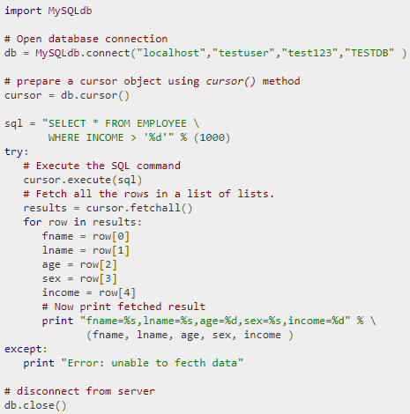
Database
.
Example:

Slide 11
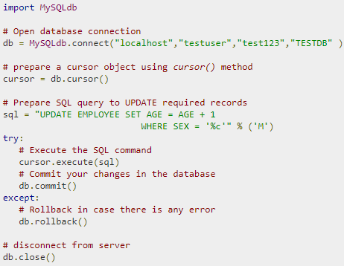
Database
Update Operation:
UPDATE Operation on any database means to update one or more records, which are already available in the database.

Slide 12
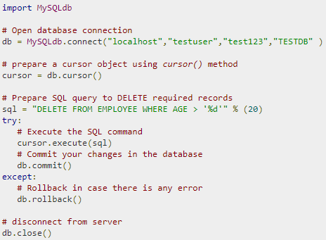
Database
DELETE Operation:
DELETE operation is required when you want to delete some records from your database.

Slide 13
Database
COMMIT Operation:
Commit is the operation, which gives a green signal to database to finalize the changes, and after this operation, no change can be reverted back.
ROLLBACK Operation:
If you are not satisfied with one or more of the changes and you want to revert back those changes completely, then use rollback() method.
Disconnecting Database
To disconnect Database connection, use close() method

